Slide 1
QI Project
Getting the diagnosis right for patients on the Asthma register
[your name]

Slide 2
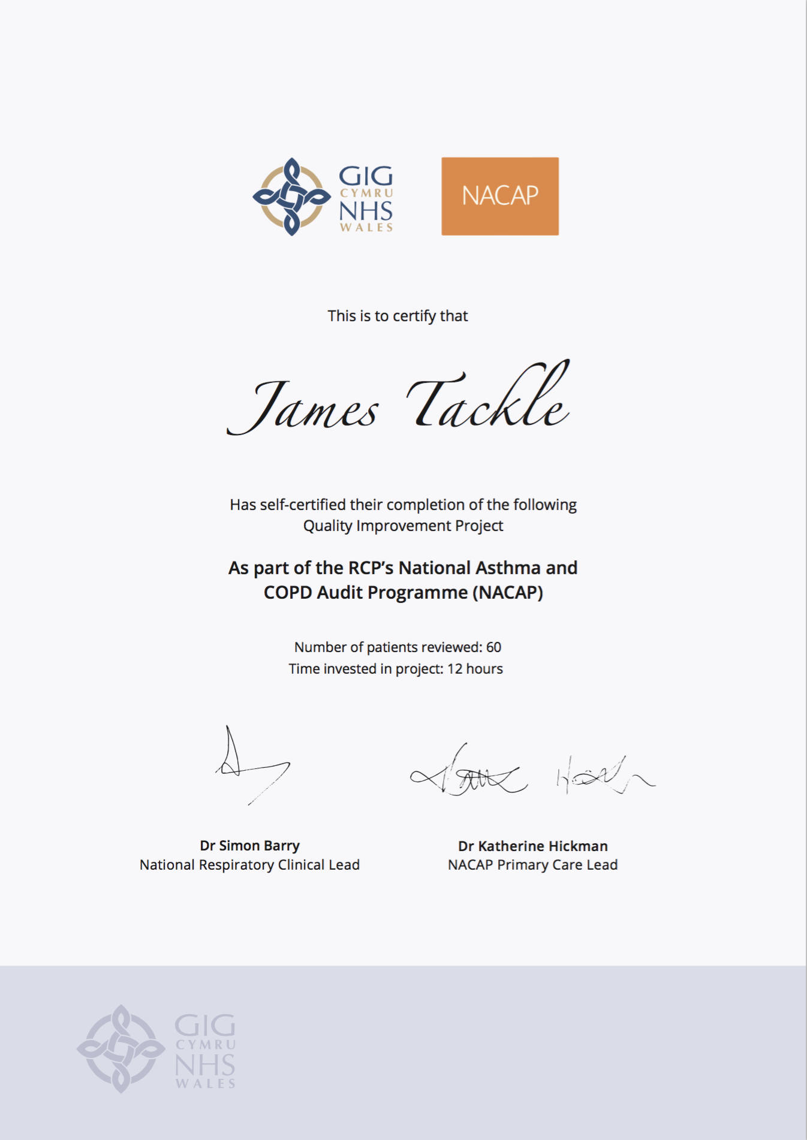
Quality Improvement with ICST
Allowing you to achieve incremental and measurable changes to make a real difference to patients

Slide 3
WHAT IS THE PROBLEM?
Data collected from GP practices across Wales suggest that only 76.3% adult patients and 67.4% children and young people patients on the Asthma registers have evidence of any tests results that can be used to support their diagnosis.
This QI project will ensure that every patient has the correct evidence to support their diagnosis of Asthma.

Slide 4
The QI project – fixing the Asthma register
Step 1 – Identify your Asthma register
Identify every patient on your Asthma register (both adults and children).
Step 2 – Sort your patients
Sort your Asthma patients by those who have evidence of Spirometry, Peak flow diary or Fractional exhaled nitric oxide
Step 3 – Check for evidence of variation
For those patients who DO have diagnostic test results on their record, check these results for evidence of variation. If there is evidence of variation, you have confirmed the diagnosis of Asthma. Make sure the diagnostic code reflects this.
Step 4 – Check the diagnosis
For those patients who DO NOT have any test results in their records, invite the patient in for a review of their diagnosis (see the next QI project in the series for more details).

Slide 5
I propose…
As a practice, we have 900 patients with Asthma on our register. I propose we review the diagnosis of 100 of these patients before July 2021. Each patient review will take 10 minutes.

Slide 6
ANY QUESTIONS?
Getting the diagnosis right for patients on the Asthma register
[your name]

